Slide 1


INITIAL APPROACH TO LIBRARY MANAGEMENT SYSTEM
Group members
Our Motive
Arko Kundu
Dipayan Paul
Purnendu Naskar
Rishav Saha
Swastik Sarkar
Help students to access the library in digital mode.

Slide 2

CONTENTS
1
Objective
2
Overview
3
DFD Model
4
Software Requirements for making Website
5
Pages inside the Website
6
Conclusion
7
Further Modifications

Slide 3
OBJECTIVE
The objective of the Library Management System is to handle the entire activity of a library.
The website keeps a record of all the information about the books and the students through MYSQL database.
The user i.e the students could only enter through their own library id and password which acts as a security feature.

Slide 4
OVERVIEW
Implementation starts with entering and updating master records like Book Details , Student Details.
When books are borrowed , it will automatically update the current books.
It will make a track on how many books are demanded, borrowed in a digital form.

Slide 5
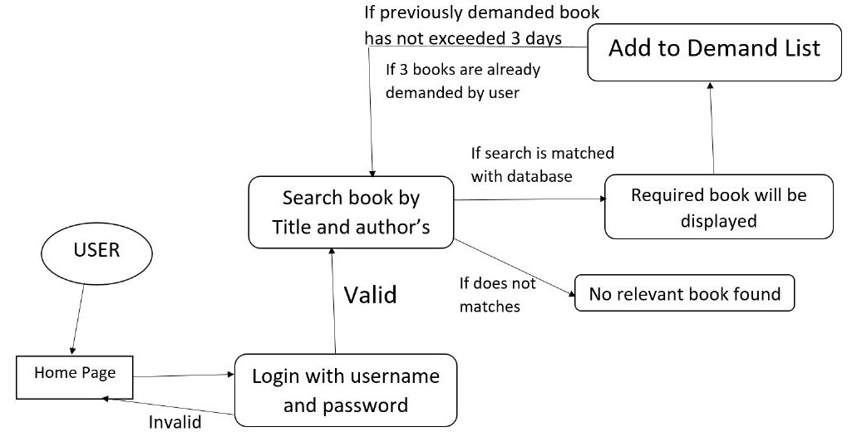
DFD MODEL

Slide 6

SOFTWARE REQUIREMENTS for Making Website

Slide 7



FRONT-END LANGUAGE
HTML
CSS
JavaScript

Slide 8

BACK-END LANGUAGE
PHP
Java Script

Slide 9

DATABASE SERVER
MySQL

Slide 10

Web SERVER
XAMPP

Slide 11

SOURCE CODE EDITOR
Visual Studio Code

Slide 12

HTML
The HyperText Markup Language or HTML is the standard markup language for documents designed to be displayed in a web browser. Web browsers receive HTML documents from a web server or from local storage and render the documents into multimedia web pages. HTML describes the structure of a web page semantically and originally included cues for the appearance of the document.

Slide 13

CSS
Cascading Style Sheets (CSS) is a style sheet language used for describing the presentation of a document written in a markup language such as HTML.
CSS is designed to enable the separation of content and presentation, including layout, colors, and fonts.

Slide 14

JAVA SCRIPT
JavaScript is a programming language that is one of the core technologies of the World Wide Web, alongside HTML and CSS. It has application programming interfaces (APIs) for working with text, dates, regular expressions, standard data structures, and the Document Object Model (DOM).

Slide 15

WEBSITE REQUIREMENTS
PHP is a general-purpose scripting language geared toward web development.
PHP originally stood for Personal Home Page, but it now stands for the recursive initialism PHP: Hypertext Preprocessor.
On a web server, the result of the interpreted and executed PHP code – which may be any type of data, such as generated HTML or binary image data – would form the whole or part of an HTTP response.
PHP

Slide 16

WEBSITE REQUIREMENTS
MySQL is an open-source relational database management system (RDBMS).
A relational database organizes data into one or more data tables in which data may be related to each other; these relations help structure the data. SQL is a language programmers use to create, modify and extract data from the relational database, as well as control user access to the database.
MY SQL

Slide 17

WEBSITE REQUIREMENTS
XAMPP is a free and open-source cross-platform web server solution stack package developed by Apache Friends, consisting mainly of the Apache HTTP Server, MariaDB database, and interpreters for scripts written in the PHP and Perl programming languages.
Since most actual web server deployments use the same components as XAMPP, it makes transitioning from a local test server to a live server possible.
XAMPP

Slide 18
WEBSITE REQUIREMENTS
Visual Studio Code, also commonly referred to as VS Code, is a source-code editor made by Microsoft with the Electron Framework, for Windows, Linux and macOS. Features include support for debugging, syntax highlighting, intelligent code completion, snippets, code refactoring, and embedded Git. Users can change the theme, keyboard shortcuts, preferences, and install extensions that add additional functionality.
VS CODE

Slide 19
Pages inside the Website

Slide 20
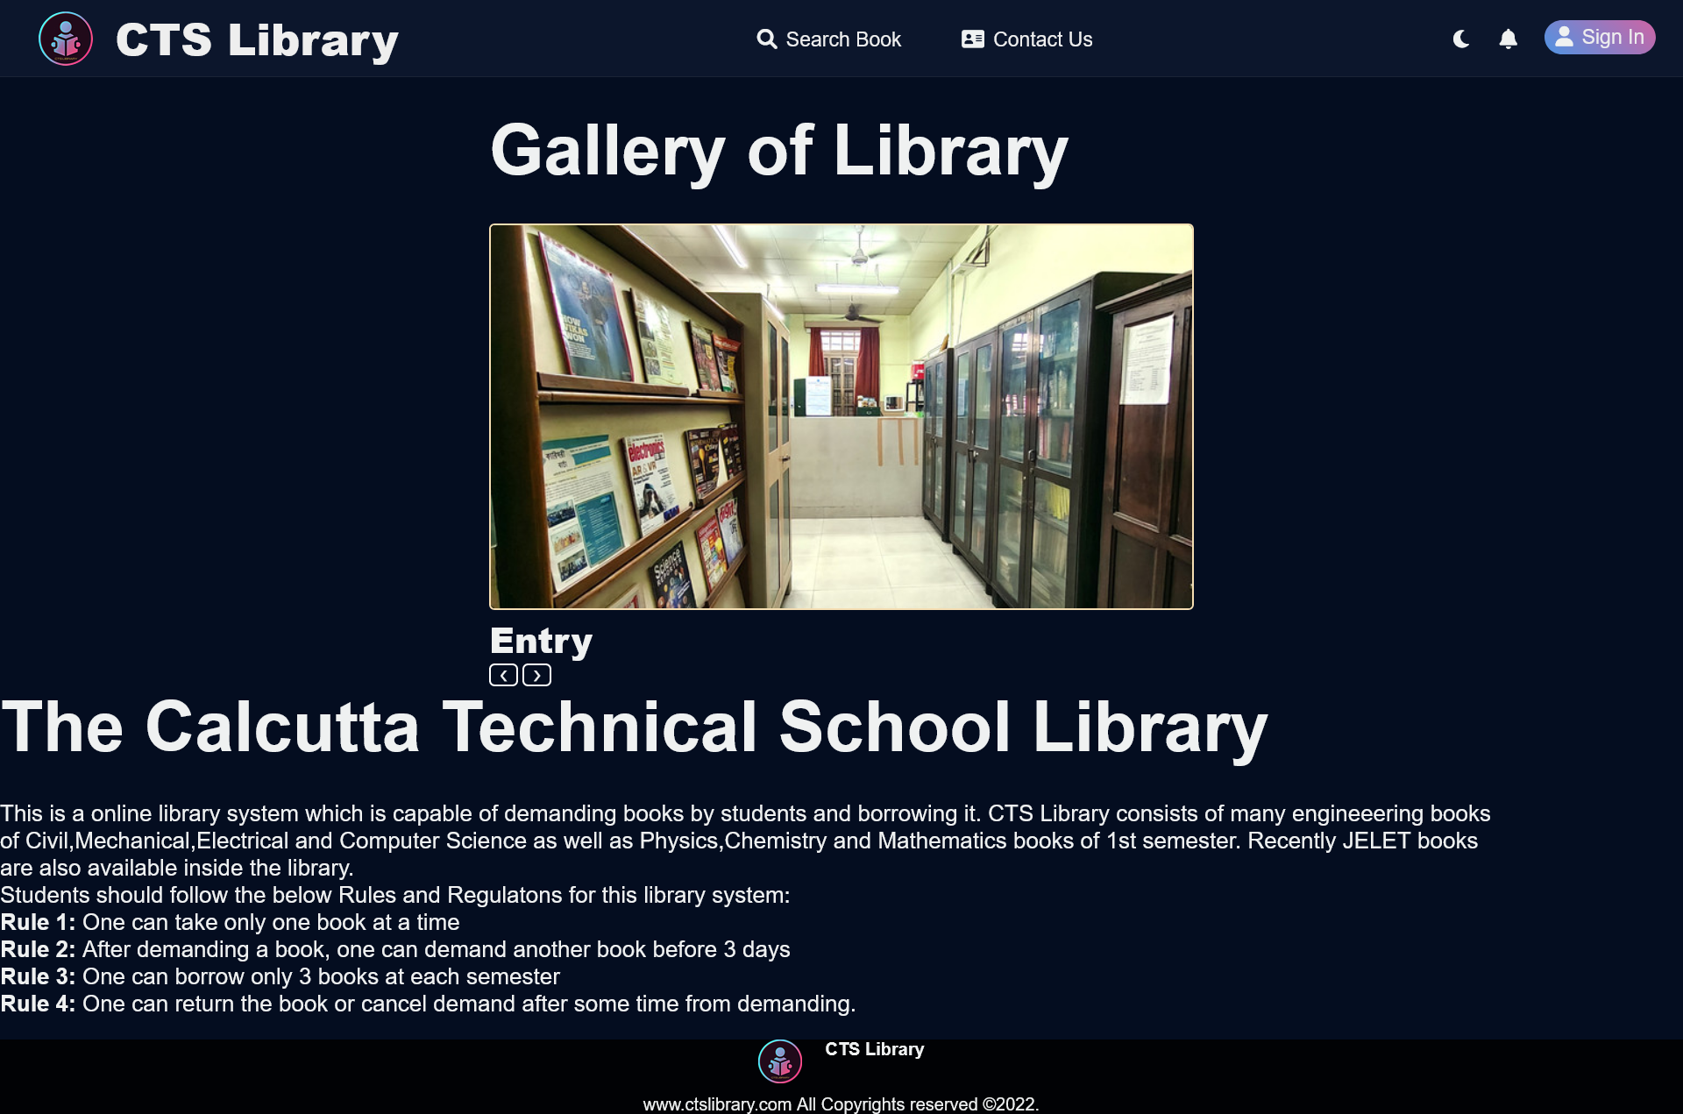
ABOUT PAGE

Slide 21
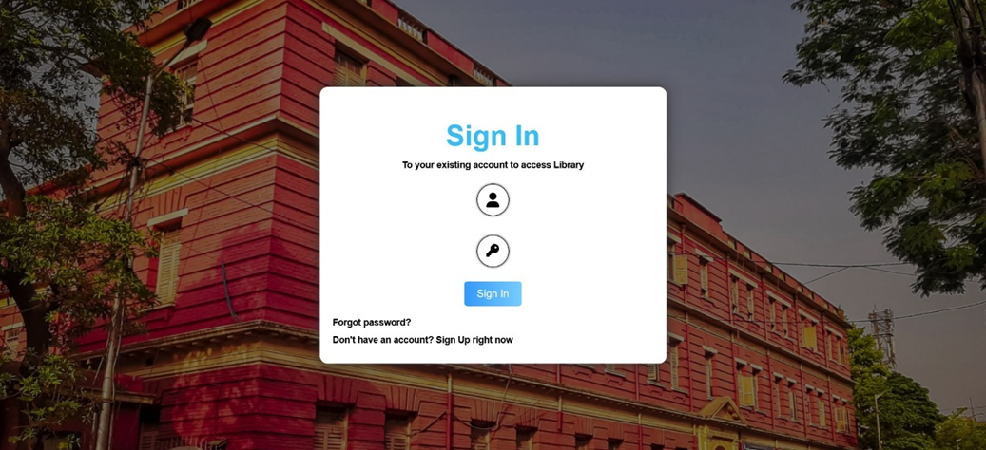
SIGN IN PAGE

Slide 22
SIGN IN PAGE

Slide 23
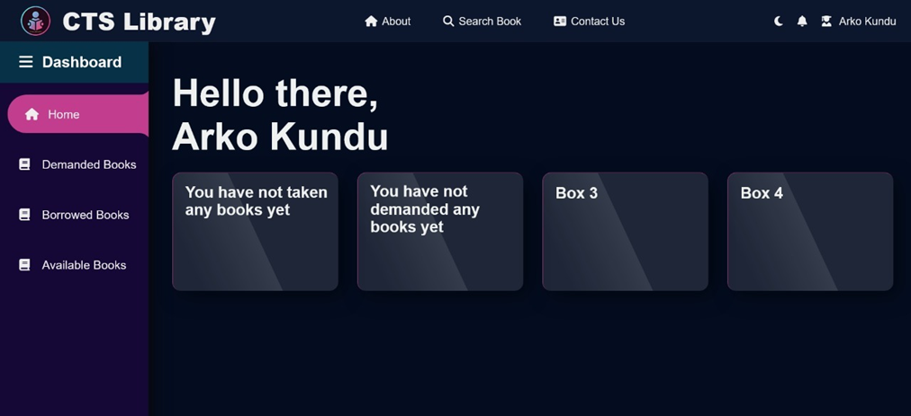
STUDENT DASHBOARD

Slide 24
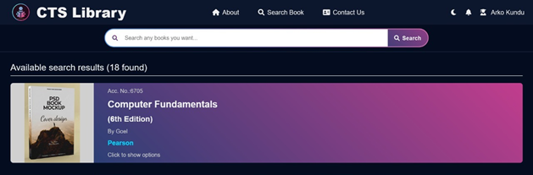
SEARCH PAGE

Slide 25
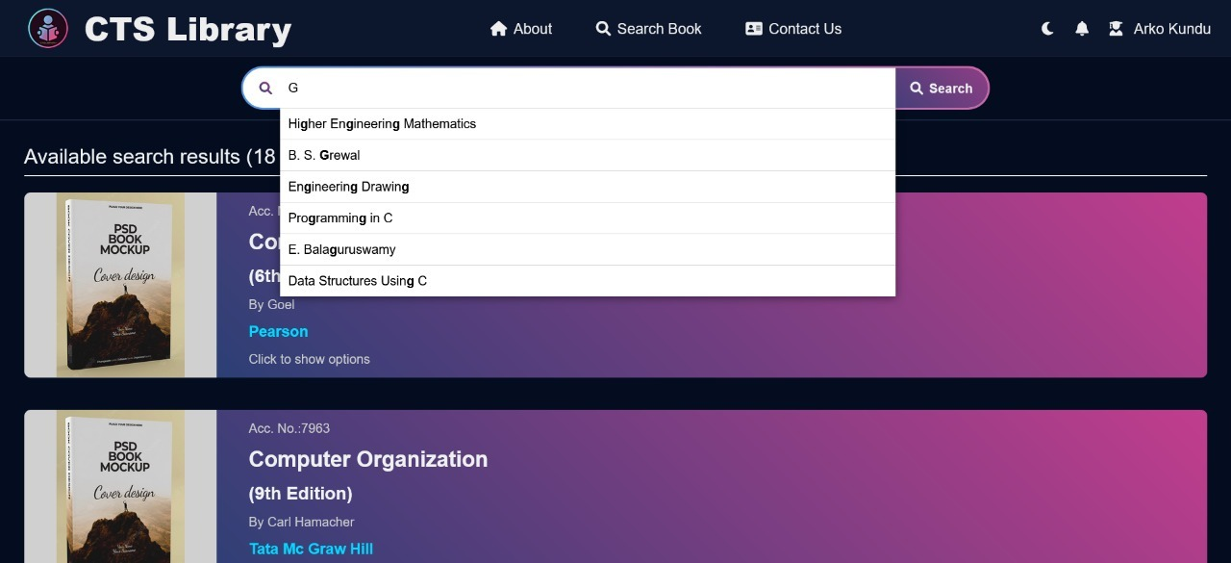
SEARCH PAGE

Slide 26
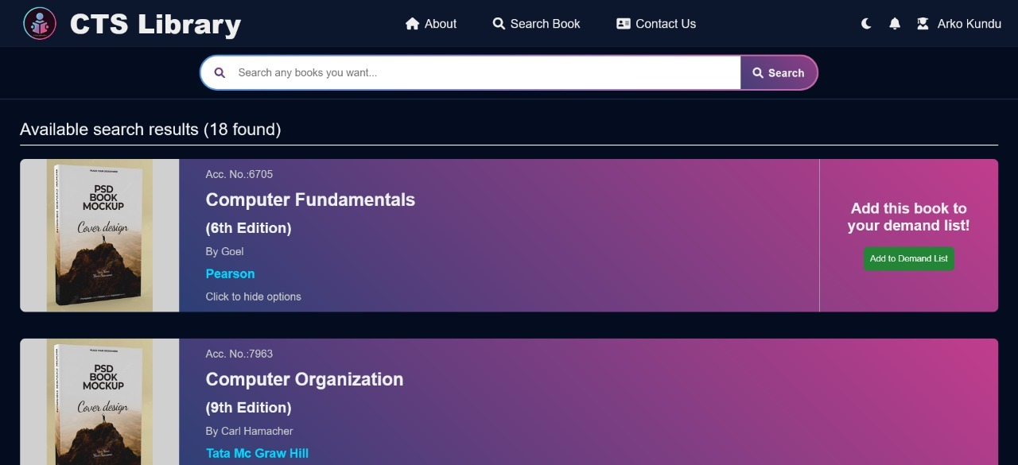
SEARCH PAGE

Slide 27
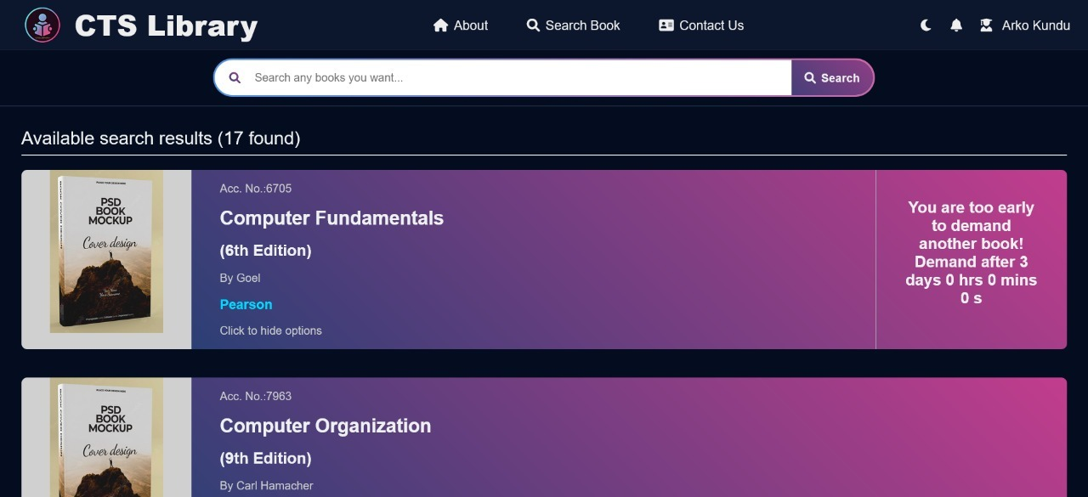
SEARCH PAGE

Slide 28

SEARCH PAGE

Slide 29
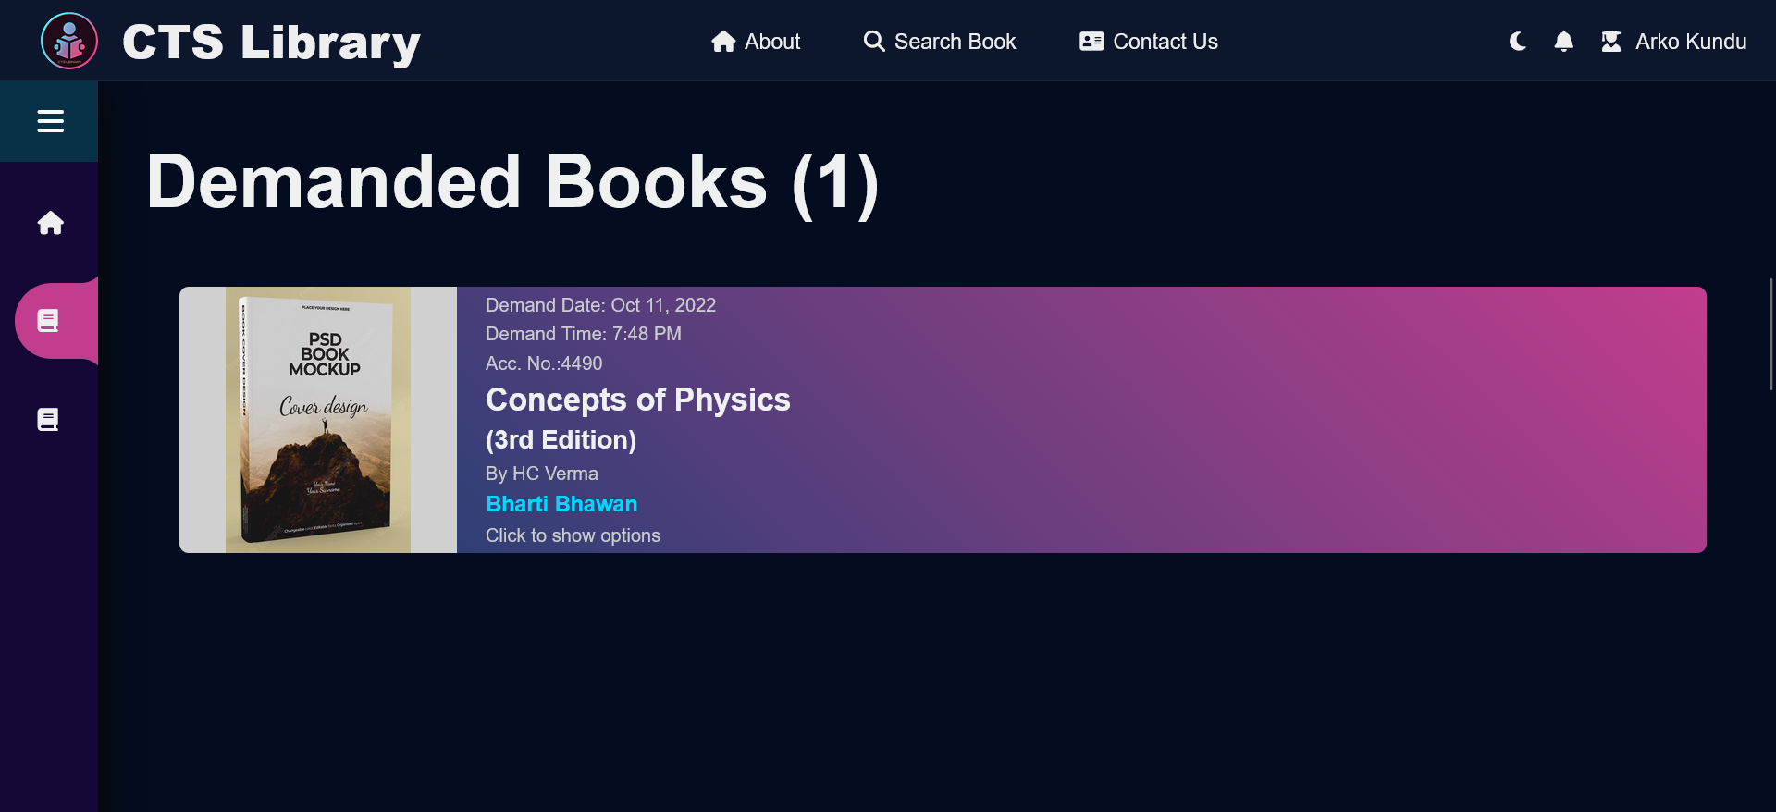
DEMANDED BOOKS

Slide 30
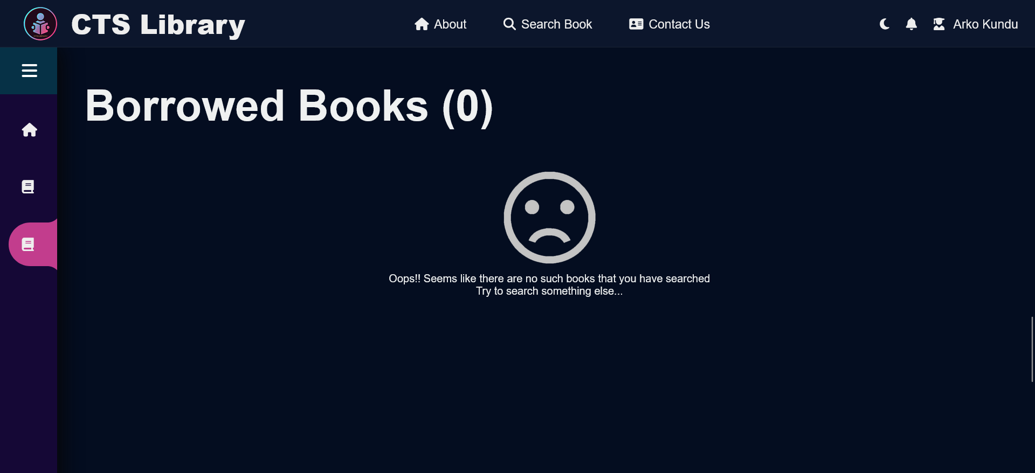
BORROWED BOOKS

Slide 31
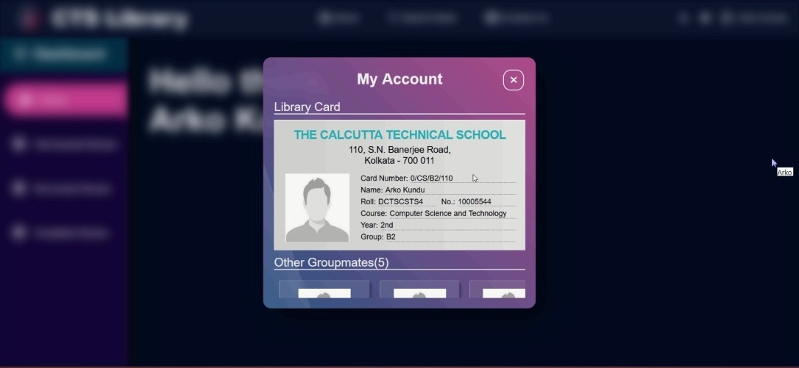
MY ACCOUNT PAGE

Slide 32
MY ACCOUNT PAGE

Slide 33
CONCLUSION
This website provides a computerized version of library management system which will benefit the students.
It also has a facility for student login where student can login and can see status of books issued as well demand for book.
Students can also see who are their groupmates by clicking on theirs account page.

Slide 34
FURTHER MODIFICATIONS
The future scope of this library system are :
1.Forgot password feature
2.Profile change by user feature
3.Full Admin supported system
4.Settings modification as required.
and lot more.....

Slide 35

THANK YOU

